Slide 1

Data Management Roadmap
Building an Information Architecture Strategy

Slide 2

Why a Data Management Framework ?
Phase 1 of the SAP implementation has required considerable effort to load, cleanse and cleanup data related issues (across all systems)
Need a central repository for documenting data knowledge extracted from the departing consultants
Data management is not cheap and will require a number of resources to monitor and maintain data integrity
  This is a challenge while we continue to iterate the SAP environment and accommodate additional features.
  This is going to be an even bigger challenge once we add in M&A activity. (it’s not going to get any cheaper)
Phase 2 of the SAP implementation will require another level of planning, execution and support to maintain data integrity

Slide 3
What is a Data Management Framework ?
Data Management consists of 3 core areas
  Data Modeling
    Data Definitions (Elements & Attributes)
    Data Relationships (Direct & Indirect)
    Metadata (Business Rules, Constraints, Logic)
  Data Analysis
    Profiling (Patterns, Anomalies, Mapping)
    Auditing (Monitoring, Detection)
    Cleansing (Automated & Manual)
  Data Integration
    Data Sources to Data Sources
    Applications to Applications
    Batch, Real-Time, Large Data Volumes
Metadata supports the 3 core areas by providing reuse and consistency
Governance enforces standards and compliance to support the process
Governance
Data Integration
Data Analysis
Metadata
Governance
Governance
Data Modeling
Governance
Notes:
__________________Rogers Notes_____________________________________
What are the business drivers within your business?
Thats what we other companies see as their business drivers.
Some of them may apply to you as well. Discuss that!
What is relevant!
Discuss priorities and implications on IT!

Slide 4
Data Management at Hospira Today
In the current environment...
Business and IT are reacting to data issues
Significant manual discovery is required to identify and resolve data issues.
Decisions made within system silos which create impacts to other systems
Lack of visibility across systems impacts ability to deliver “first-visit” incident resolution
 | Scenarios | Current Data Management Process
 | Missing Lot # in Delphi | Manual analysis of relevant systems and interfaces Reactive implementation incidents and break/fix tickets
 | Employee Information | SAP HR not fully integrated into Hospira's security framework (AD, ID-Sync) Limited integration with identity management Contractors not maintained in SAP HR
 | Security & Role Sync | Security related information in SAP HR is not complete for all systems SAP HR not fully integrated into Hospira's security framework (AD, ID-Sync)
 | Master Data Creation (New Product Intro) | Manual process for CMMG to get new product #'s from Marketing Load to production using manual controls (blocking) Custom material audit based on known SAP issues Reactive implementation incidents and break/fix tickets
 | Master Data Archive (Customer) | No processes for end-of-life data in SAP Manual controls w/in SAP can impact downstream systems Reactive implementation incidents and break/fix tickets
 | Master Data Design Change (Material Master) | Manual communication of design changes Manual, system-specific impact analysis Reactive implementation incidents and break/fix tickets
 | Acquisition Integration | Manual assimilation of new products, product families, classification structures, etc. Manual analysis of naming conventions, mappings, data sharing, system flows
Data
Governance /
Process
Business
Agility

Slide 5
Future Data Management Lifecycle
Data Modeling
Data Analysis
Data Integration
Create/Update Data Model across targeted systems that impact the (in scope) data elements (lifecycle)
Proactively identify gaps in data elements across systems
Provide cross-system visibility to business and data owners
Conduct structured, proactive impact analysis of data model changes in staging Support extension of data model as additional systems targeted
Leverage governance model for planning and managing change
Conduct data profiling & auditing to validate gaps in the data model
Proactively identify gaps in data values across systems
Provide cross-system visibility to data for business owners
Enable structured cross-system data cleansing, mapping, transformation and rationalization rules
Support ability to leverage governance model for approval, publication, and extension of data
Apply the transformation rules (identified in Data Analysis) to the data silos and ensure data integrity for the "gold source" to support publish & subscribe.
Reduce Risk using data staging.
Reduce Effort for Change Mgmt, Training & Implementation Costs
Improve agility of governance model by centralizing controls and focusing validation, training, and change management
The future is about building a sustainable, scaleable framework for managing the lifecycle for enterprise data. The 3 components will provide consistency, support reusability and improve quality while reducing our overall costs and allow us to maintain control over costs as our data management needs grow in the future.

Slide 6
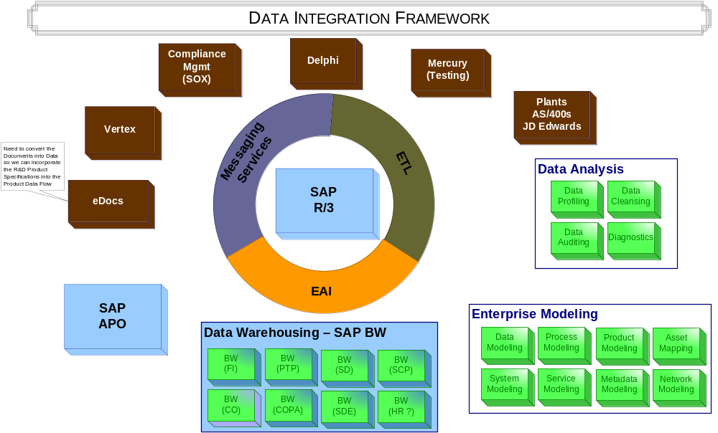
Data Management Vision
Notes:
__________________Rogers Notes_____________________________________
What are the business drivers within your business?
Thats what we other companies see as their business drivers.
Some of them may apply to you as well. Discuss that!
What is relevant!
Discuss priorities and implications on IT!

Slide 7
Data Management Roadmap
Data Integration
Integrate validated rules and processes for data governance into data processes
Automate workflows for data review and approval
Leverage approved data management services vs. system load and deploy
Improve agility of business to reduce data related process/ service constraints
Data Analysis
Update & Extend
Define rules for new processing
Support new project data governance
Continuous improvement for data models and data management processes
Cleanse, & load first waves of new data
Features / Benefits
Define & Cleanse
Cleanse existing data
Cleanse Data processes / interfaces
Data gold source enforcement
Data Modeling
Data Model
Interfaces
KDEs / Processes
Enforce consistent, validated business rules across users and applications
Publish/Subscribe implementation / support
Structured impact analysis for data model changes
Update model based on Mfg blueprint
Data analysis based on Meta Data
Define data gold sources
Define Meta Data
Review processes against model
Time
Notes:
__________________Rogers Notes_____________________________________
What are the business drivers within your business?
Thats what we other companies see as their business drivers.
Some of them may apply to you as well. Discuss that!
What is relevant!
Discuss priorities and implications on IT!

Slide 8
Data Management Benefits
 | Reduce Costs | Support Business Agility & Growth | Improve Stability & Scalability
Data Modeling | Reduce Manual Workload for Diagnosis Simplified analysis for identifying dependencies | Improved control enables faster change management Ability to connect strategic vision to tactical implementation | Centralized model for all data Applying metadata to data manipulation improves consistency Improve knowledge transfer
Data Analysis | Proactive cleansing & profiling reduces rework Ability to improve data ETL processes for SAP MFG project Changes to data easier to develop/integrate | Easy to adapt metadata to meet business needs Ability to integrate metadata into a single set of tools for Profiling, Auditing & Cleansing | Ability to improve data quality across each technology layers and organizational boundaries Apply Business Rules consistently
Data Integration | Ability to improve day-to-day operations Outsourcing of standard processes/services Changes to data easier to develop/integrate | Lower integration effort (applications + partners) Pre-configured business content Simplify Integration Planning Increased flexibility for planning and managing data changes | Ability to align data across the enterprise Centralized management of applied metadata Automation of manual processes Support consistency in data manipulation and transforms Automate enforcement of Business Rules

Slide 9
What’s in it for me ?
Benefits Mapping Matrix
 | Features | Office of CIO | App Mgmt MFG, QA, R&D | App Mgmt Commercial | App Mgmt Corporate | Strat Tech & Integ | IT Ops
 | Ability to plan change & predict impact analysis BEFORE changes are applied. | X | X | X | X | X | X
 | Ability to reduce data replication |  | X | X | X | X | X
 | Ability to improve data integrity | X | X | X | X | X
 | Ability to reduce application complexity |  | X | X | X | X | X
 | Ability to reduce application support costs |  | X | X | X | X | X
 | Ability to improve application resiliency |  | X | X | X | X
 | Ability to reduce the impact of data errors to the business | X | X | X | X | X
 | Ability to build reliable data warehouses which are more adaptable & agile | X | X | X | X | X
 | Ability to build in data integrity for the existing SAP installation | X | X |  |  | X
 | Ability to proactively analyze data and build data cleansing and auditing capabilities into the SAP MFG project |  | X |  |  | X
 | Ability to reduce the support required for data investigation & resolving data errors |  | X | X | X | X
 | Ability to reduce the impact of data errors to the business | X | X | X | X | X
 | Ability to build reliable data warehouses which are more adaptable & agile | X | X | X | X | X | X
NON-SAP
SAP

Slide 10

We need to shift our way of thinking about data
Traditional
Progressive
Shift Focus to Model-Driven Approach
Application-centric
ERP is the centerpiece
Data is the foundation
Metadata drives the enterprise
Integration depends on data
Function oriented
Build to last
Long development cycles
Application silos
Tightly coupled
Object oriented
Known implementation
Process oriented
Build to change
Agility & Adoptability
Orchestrated solutions
Loosely coupled
Message oriented
Metadata Driven
Shift in Information Architecture Strategy
Data Integrity is a competitive necessity
Adaptability, Agility and Accountability can drive competitive advantage
Data Management is the cornerstone for building an Information Architecture
Information Architecture will enable Hospira to better deploy and realize benefits from formalized tools, processes & governance
Notes:
-------------------------------------------------------------ROGER---------------------------------------------------------------
SAP has learned that current requirements can not be delivered by a monolithic R/3 architecture.
Current restrictions:
Multiserver environment
Decentral data management
P2P integration
Poor reuse of assets/programs within SAP
Monolithic structure unlikely to adapt change
→ Integration is the story (services, partners, data…)

Slide 11
Key Messages
We are not going to build this overnight. We are proposing an evolutionary approach towards building an Information Architecture
Tools and technologies will not automatically give you an Information Architecture
Architecture without good data will not succeed
Architecture without governance will NOT realize full value
Need to build a sustainable, scalable (data is doubling every 2yrs) foundation for ensuring data integrity and managing this core asset upon which business decisions are made.
Need to develop a core competency around Modeling, Analyzing & Integrating data to support business growth & the increasing pace of change.

Slide 12
Investment Planning
The investment in Tools, Processes and Governance is split into 3 separate areas:
  Data Modeling
  Data Analysis
  Data Integration
Investment Planning Summary
Breakdown | Data Modeling | Data Analysis | Data Integration | Totals
License Fees | $36,000 | $216,000 | $234,000 | $486,000
Maintenance | $3,680 | $54,000 | $58,500 | $116,180
Installation & Training Fees | $20,000 | $28,000 | $29,000 | $77,000
Hardware Purchase | $8,500 | $24,500 | $16,000 | $49,000
Projects (Implementation for SAP) | $136,200 | $233,600 | $116,800 | $486,600
Total Estimated Investment | $204,380 | $556,100 | $454,300 | $1,214,780

Slide 13
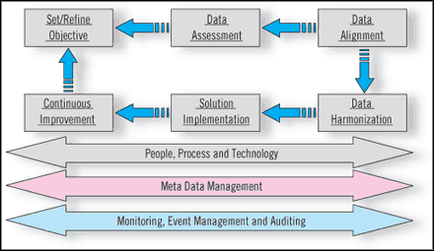
Appendix: Data Management Framework

Slide 14
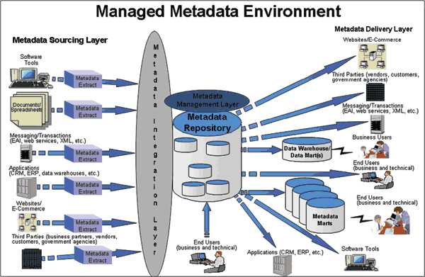
Appendix: Metadata Management Environment

